Slide 1
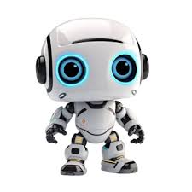
ARTIFICAL INTELLIGENCE ~PRESENTATION BY ZEEL THAKKAR

Slide 2
CONTENTS
WHAT IS ARTIFICIAL INTELLIGENCE ?
HOW MACHINE LEARNING IS RELATED ?
EXAMPLES OF AI
WHAT PROBLEMS CAN AI SOLVE ?
DISADVANTAGES OF AI
HOW CAN WE USE AI RESPONSIBLY ?

Slide 3
1. WHAT IS AI ?
Artificial Intelligence is the ability for a computer to think, learn and simulate human mental processes, such as perceiving, reasoning, and learning.
It can also independently perform complex tasks that once required human input.

Slide 4
2. HOW MACHINE LEARNING IS RELATED ?
Although the terms artificial intelligence (AI) and machine learning are frequently used interchangeably, (machine learning is a subset of the larger category of Ai.
Artificial intelligence signifies computers' general ability to mimic human thought while carrying out tasks in real-world environments
Machine learning implies to the technologies and algorithms that allow systems to recognize patterns, make decisions, and improve themselves through experience and data.

Slide 5
3. EXAMPLES OF AI
Virtual Assistance
AI can be used for various situations, but these are some examples of AI in our daily life.
Recommendation systems
Autonomous vehicles
Navigation apps
Chatbots
Facial recognition
E-commerce
Text editors

Slide 6
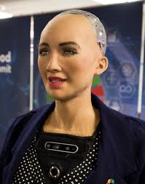
SOFIA THE AI ROBOT
Sophia is a realistic humanoid robot capable of displaying humanlike expressions and interacting with people. It's designed for research, education, and entertainment, and helps promote public discussion about AI ethics and the future of robotics.

Slide 7
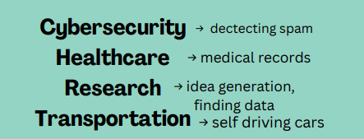

4. WHAT PROBLEMS CAN AI SOLVE?
As shown above, AI can solve a LOT of problems. Let's explore a few on the next slide!

Slide 8
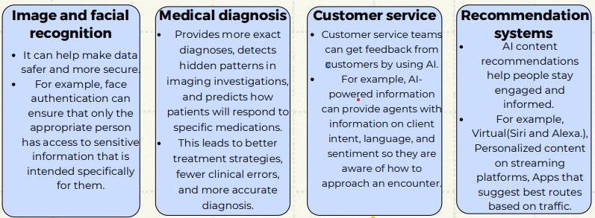
USES OF AI (ADVANTAGES OF AI)

Slide 9

5. what are the disadvantages of AI?
Lack of Transparency
Bias and Discrimination
Privacy Concerns
Ethical Dilemmas
Security Risks
Concentration of Power
Dependence on AI
Job Displacement

Slide 10
6. how can we use AI responsibly?
People should use their own creativity, not copy off of AI! AI is just a tool for efficiency!
Put People First
Consider data and privacy goals
Minimize unintended bias
Ensure AI transparency

Slide 11
RESPONSIBLE USE OF AI
AI can help do repetitive work for humans, but humans should still be prioritized. Create a culture that utilizes creativity, empathy, and dexterity from humans and AI for increased efficiency.
Businesses should adopt strong security measures, limit access to sensitive data, and anonymize data whenever possible to secure data privacy with AI and ML technologies.
There needs to be fairness in AI which entails identifying and eliminating discrimination while also encouraging diversity and inclusion. This is can be done by using training models with equal representation
Develop explainable AI that is visible across processes and functions to generate trust among employees and customers. Provide examinability, comprehension, and traceability.

Slide 12
THANKS FOR LISTENING ! ANY QUESTIONS ?

